Slide 1

Text Analytics on Customer’s reviews on Amazon Products AGENO SCHOOL OF BUSINESS Golden Gate University MSBA 327- Text Analytics Xiaowei Guan, Ph.D. Fall 2020 Buse Bastug, SID: 0598594 Reena Sehitya​, SID: 0597218​ 12/20/2020
Fig:1
Notes:
Reference:
Ghelber, A. (2020, March 04). Amazon Review Analysis: The Beginners Guide (2020) [Digital image]. Retrieved December 18, 2020, from https://www.revuze.it/blog/amazon-review-analysis/

Slide 2
Agenda
Introduction
Dataset
Analysis Flow
Recommendation
Conclusion
Reference

Slide 3
Introduction
Amazon is is the uncontested ecommerce leader with over 300 million active users
It has consistently growing products potential and product reviews. With the vast amount of consumer reviews, this creates an opportunity to see how the market reacts to a specific product (Zhang, 2020)
Our major goals to achieve in this paper are:
To deeply analyze text reviews and ratings to comprehend what people say good or bad about price and products that are being sold by Amazon on its own website
To train the model based on sentiment labels and text reviews given by customers for Amazon products using classification algorithm so that model can identify sentiments on its own on new instances of reviews with higher precision

Slide 4
Datasets
Source: Datasets used in our project are downloaded from Kaggle and originally provided by Datafiniti's Product Database
We are using three datasets for our projects that provide basic product information and are in csv format
Name of our datasets:
1429_1.csv
Datafiniti_Amazon_Consumer_Reviews_of_Amazon_Products.csv
Datafiniti_Amazon_Consumer_Reviews_of_Amazon_Products_May19
There are in total 38,000 rows and 21 columns but we are focusing on three columns for our analysis:
Id : Id represents the products that are sold by Amazon
reviews.text: This column represents reviews given by customers for each product they bought online
reviews.rating: This column represents ratings given by customers for each product they bought

Slide 5

Analysis Flow
Methodology
Text Summarization and Modeling (Buse)
Sentiment Analysis (Reena)
Text Classification and Building Concepts (Buse)
Clustering and Text Link Analysis (Buse)

Slide 6
Methodology
Methodology | Purpose | Tool
Text Summarization and Modeling | To get concepts and domain types of these concepts | IBM SPSS Modeler
Text Classification and Building Concepts | To arrive different categories to understands different reaction of different customers for the products | IBM SPSS Modeler
Clustering and Text Link Analysis | To build clusters to determine the identifiers in the data that would lead to a positive or negative review | IBM SPSS Modeler
Sentiment Analysis | To build a predictive model that can predict positive, negative and neutral sentiments with higher accuracy and precision on new instances of text reviews posted by customers for each product. | Python Jupyter Notebook

Slide 7
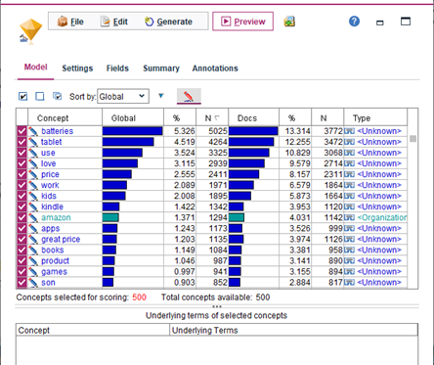
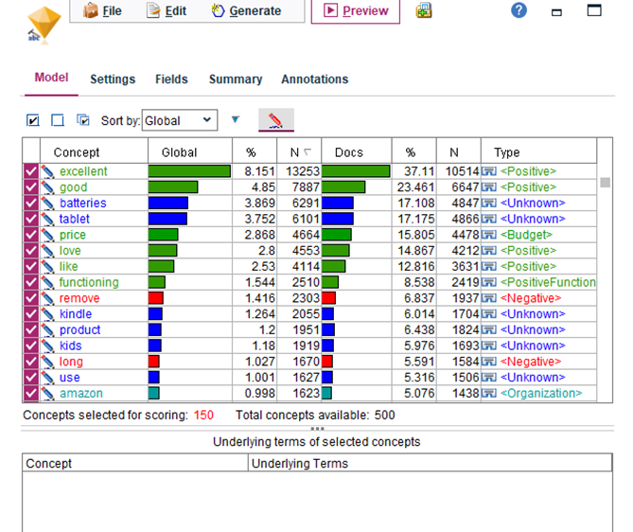
Text Summarization and Modeling (Buse)
First model (Figure 1) Second model: based on highest frequency and Opinions (English) text analysis package(Figure 2)
Notes:
The dataset was loaded into IBM SPSS Modeler by selecting Excel icon and importing as XLXS file. And then the stream was built. The analysis used a File List Node to read text from the reviews of our dataset.
As is typical when using a resources template that has not been tuned to this particular text dataset, there are some concepts with Unknown type. Also, the two most common concepts are “excellent” and “good which means the reviews are mostly in positive skew with positive type of price concept. They both appear in 23-37% of all records. (Figure 2 )

Slide 8
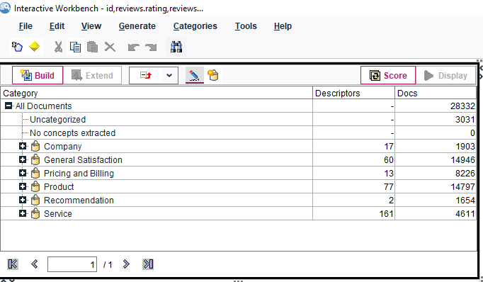
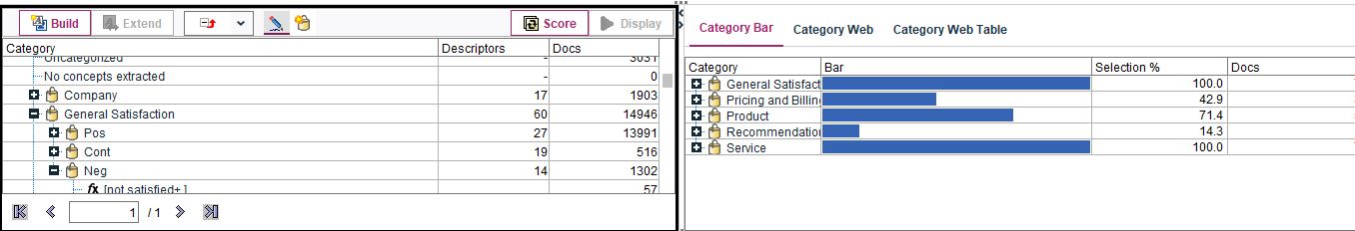
Text Classification and Building Concepts (Buse)
Notes:
After grouping and scoring all categories by using Interactive Workbench panel, the result shows that uncategorized documents are 3031 and the dataset has 6 different categories
In order to understand the customers’ reactions about what they most like & dislike of the products, we can focus on general satisfaction and pricing & billing concepts.

Slide 9
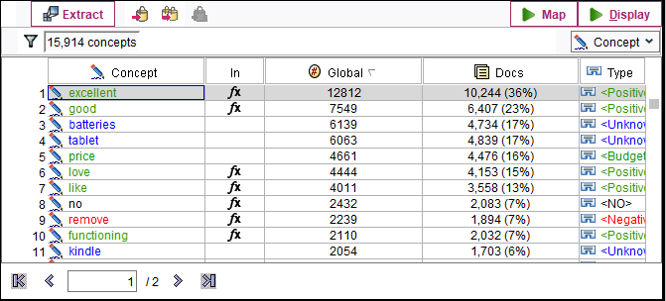
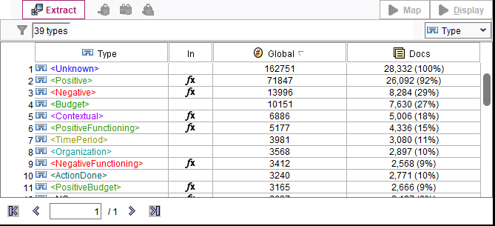
Notes:
The most popular concepts are excellent, tablet, good and battery. Excellent and good show up in 36% and 23% of documents.
The most popular types of documents are positive and negative functioning. It shows us positive docs are 92% while the negative docs are only 29% which can be seen above.

Slide 10
Notes:
After scoring the records as contextual, negative, neutral, no opinion and positive we get the scores as seen above image.

Slide 11
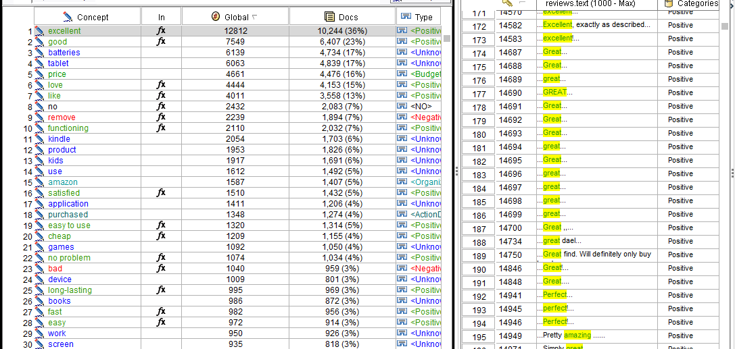
Notes:
It still shows that our dataset has more positive records than other concepts.
The main point in this analysis will be focusing on negative reviews and to detect what key words of it. Customers are generally very happy with the product they purchase.

Slide 12
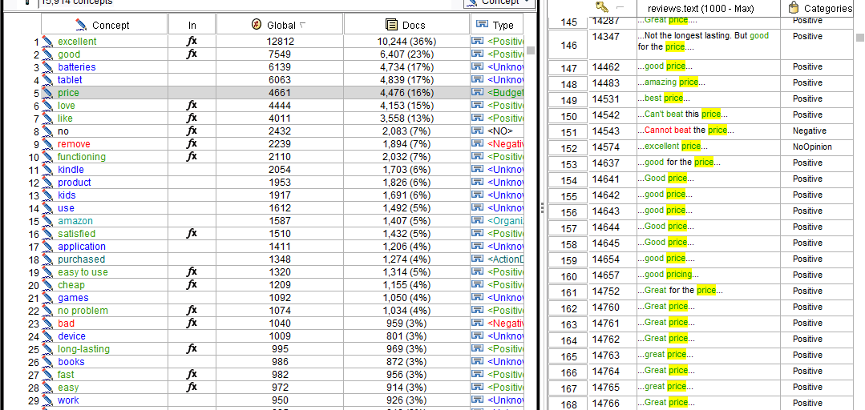
Notes:
Checking the price section, we see the relation with positive type and the texts. Mostly, price of the products meet the customers’ expectations.

Slide 13
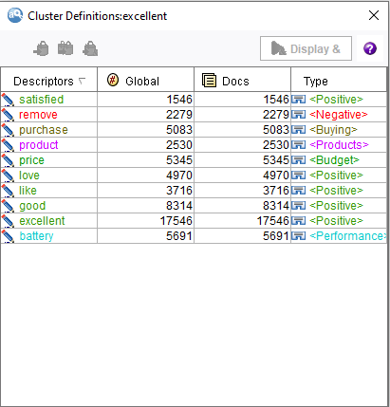
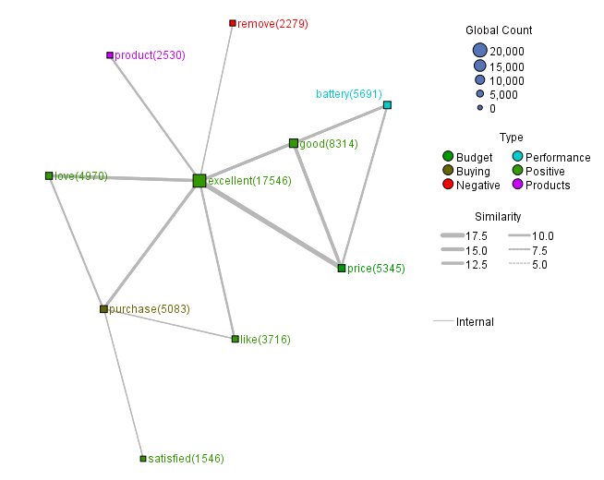
Clustering and Text Link Analysis (Buse)
Notes:
Clusters were built in order to determine the identifiers in the data that would lead to a positive or negative review.
Clusters were built utilizing these parameters:
Top number of concepts
Number based on document count: 25,000
Maximum number of clusters to create: 500
Maximum concepts in a cluster: 20
Minimum concepts in a cluster: 5
Maximum number of internal links: 20
Maximum number of external links: 20
Minimum link value: 5
After only choosing Budget, Buying, Positive, Negative, Performance and Product Types, ten clusters were defined as above.
As it can be seen above, excellent relates to price, purchase and product. For all these clusters, no negative relationships were found. Overall, IBM SPSS Modeler showed that there were more positive reviews than negative. When customers were mentioning “excellent” in their reviews for 18,000 times, “good” was mentioned for 8,000 times, respectively.
It means that certain customer responses contained the word "excellent" or "good" but not both.

Slide 14
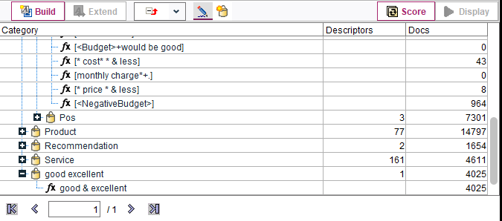
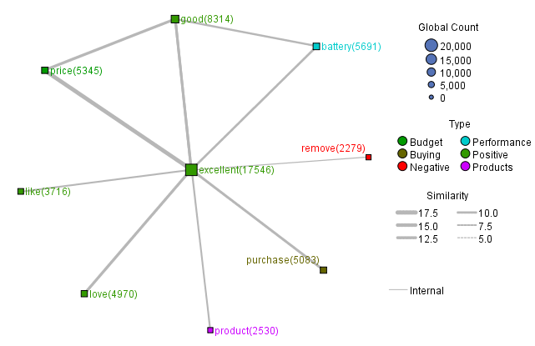
Notes:
In order to check how many times both concepts occurred together, a new category was issued under “good excellent”.
After scoring the categories and concepts tab one more time, we were able to check that both concepts has been occurred in 4025 docs.

Slide 15
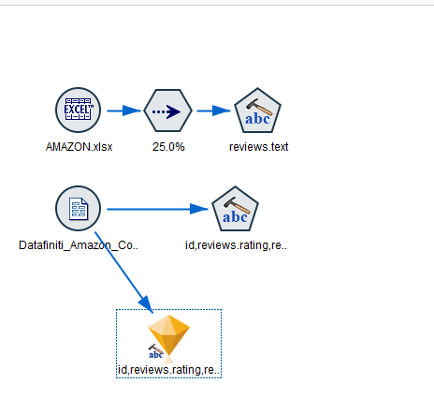
Model Output
Notes:
We performed text analysis by adding Text Mining Node to the stream and connecting to our file. This time our file have only Amazon ID, review rates and review text.
After starting the session with selecting customer satisfaction tap from the Text Analysis package, our model has been generated.(see above)
The analysis was focused products and budget concepts with their negative and positive relationships that could be valuable and effective for customers’ reviews.

Slide 16
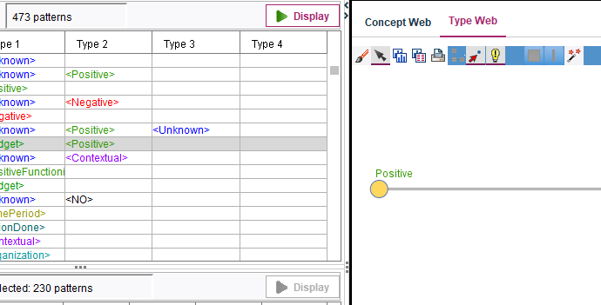
Notes:
Looking at the Text Link Analysis, we wanted to see how budget have a relationship with positive and negative reviews.

Slide 17
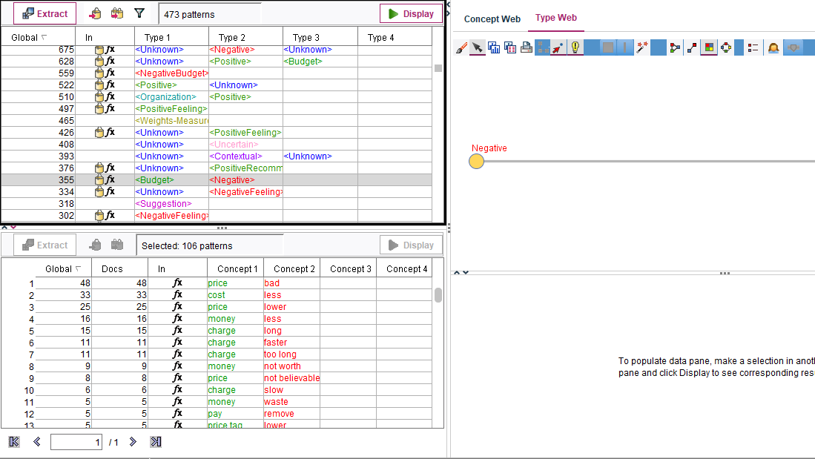
Notes:
To contrast, we looked at negative budget reviews.
Checking positive budget reviews tell us that people are happy with the price. They find the charge and prices of products good. Checking negative reviews do not tell us much. However, there is still some negative reviews exist about the money is not worth it and price could be better.

Slide 18
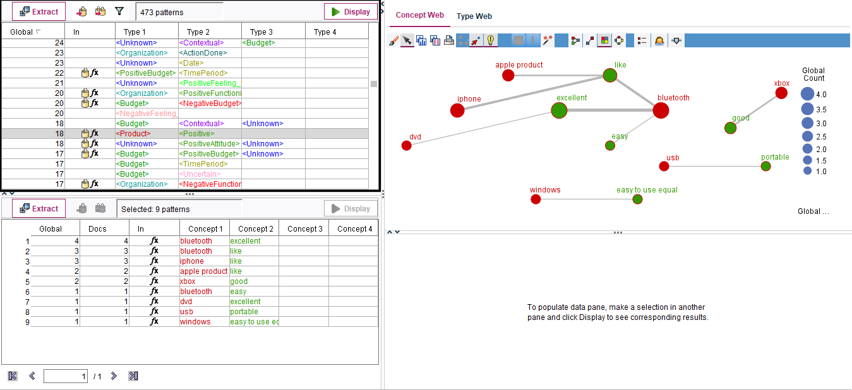
Notes:
The next step is checking what products have the negative and positive reviews and what these reviews about. By checking positive reviews of products, the result tells us that people love Apple products. The most positive reviews include excellent, like and easy keyword which related to Apple and Iphone.

Slide 19
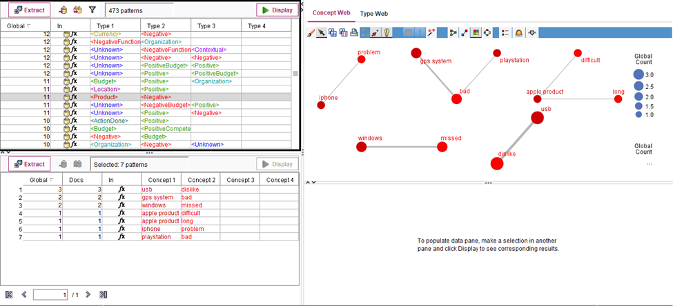
Notes:
To contrast, checking the negative reviews of product tell us that there are almost none bad reviews, and the reviews are most likely transition of one brand to another such as changing the electronic devices to Microsoft from apple and not being able to use it efficiently.

Slide 20
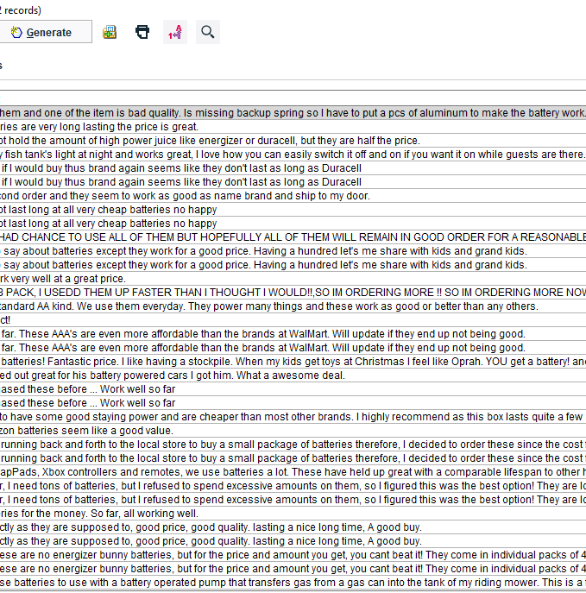
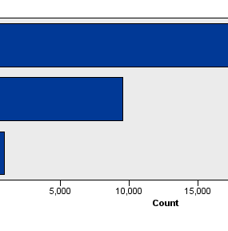
Notes:
Overall scoring sentiment analysis, it gives a clear picture of the category of reviews.

Slide 21
Sentiment Analysis (Reena)
Building predictive model (classify into positive, negative or neutral sentiment on new instance with higher precision and accuracy) involve following steps:
Data Cleaning & Pre-processing
Analysis Model
Exploratory Data Analysis
Predictive Modeling using ML algorithms
Model Results
Model Interpretation

Slide 22
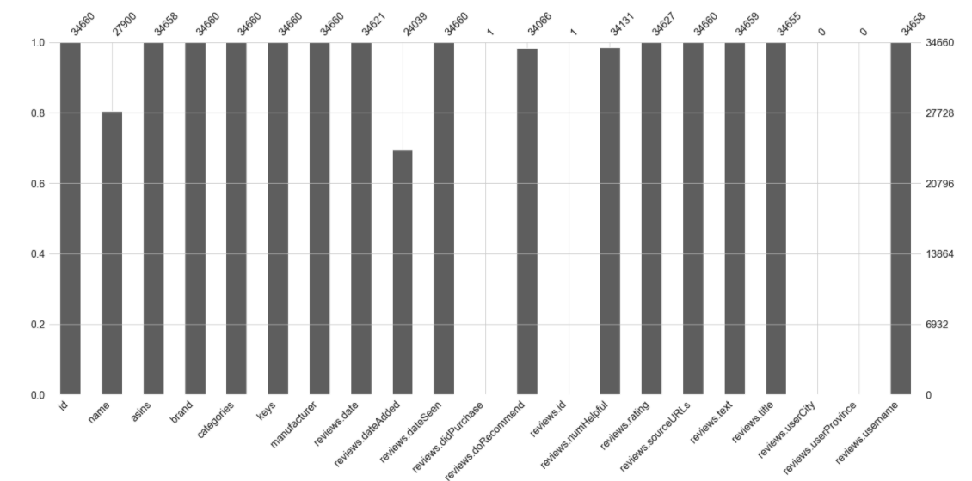
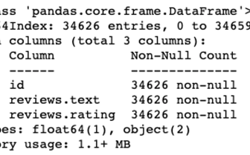
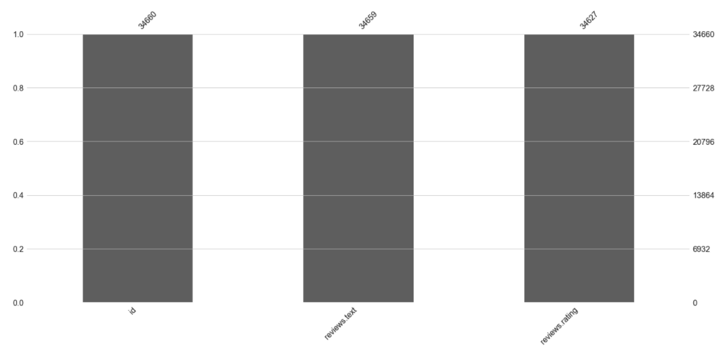
Data Cleaning & Pre-processing: (Reena)
Out of 21 columns, 14 columns had missing values
We focused on three columns where in total 34 values missing
After removing all the null values we had 34626 non-null values

Slide 23
Data Cleaning & Pre-processing contd.: (Reena)
Pre-processing involved following steps:
Lowering the case of all text (remove irregularities)
Applied tokenization method (to split each sentence into list of words )
Then applied lambda function (to make sure only the alphabetic are included in all the characters in the string )
WordNetLemmatizer method called (to normalize list of tokenized words )
Stopwords method is provoked (to eliminate the most common words in a language )
All the token words are joined after removing all the stop words
Note: we have pre-processed all the three datasets we have used to build the model

Slide 24
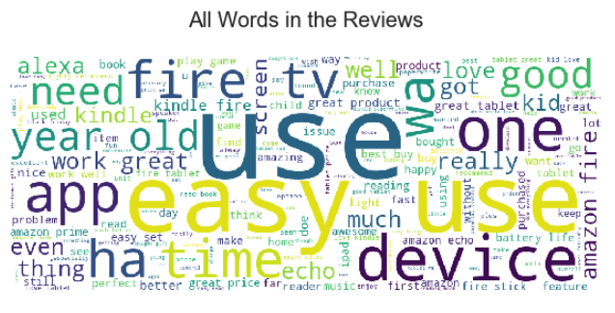
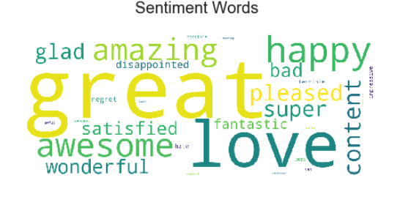
Exploratory Data Analysis (Reena)
Above Wordcloud without sentiment words
Above Wordcloud with sentiment words
Detail of this slide is in the note section
Notes:
Words in the above results doesn't convey sentiments embedded in comments. So, we performed a word count of certain words that could describe the sentiment in a better way. In order to create a word cloud of sentimental words from the reviews.text column, we ran the algorithm with the list “words” of certain sentimental words such as 'awesome', 'great', 'fantastic', 'awful', 'hate' and so on. Then mapped those words included in a variable “words” with the entire text in reviews.text column and generated a dictionary called “diz” with each element in the list used most frequently in the text column. We then generated a word cloud of dictionary “diz”
The result of the above wordcloud suggests that most of the comments are positive

Slide 25
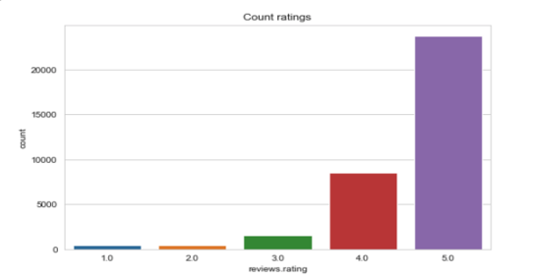
Exploratory Data Analysis contd. (Reena)
Detail of this slide is in the note section
Notes:
The above count result shows majority of the ratings is 5. This suggests that data is highly biased towards high ratings. In order to confirm the presence of biasness in our dataset, we dig further to get the average rating for every product Amazon sold.

Slide 26
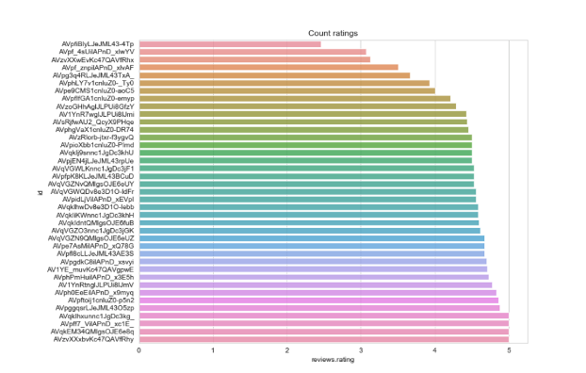
Exploratory Data Analysis contd. (Reena)
Notes:
We found average ratings per product through grouping reviews.rating column by “id” and applied mean function on ratings and assigned to a variable “data1” after sorting values in an ascending order
As we can clearly see that the reviews are heavily biased towards positive reviews and higher ratings: 4 and 5
In order to deal with this biasness of data, we decided to add the other two csv files such as Datafiniti_Amazon_Consumer_Reviews_of_Amazon_Products_May19.csv, Datafiniti_Amazon_Consumer_Reviews_of_Amazon_Products.csv and get only the reviews that have ratings lower or equal to 3. After uploading these two csv files, we copied three columns and assigned to new dataframes data2, data3 with reviews.ratings <=3 as shown below

Slide 27
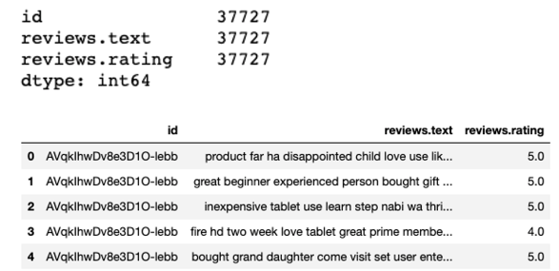
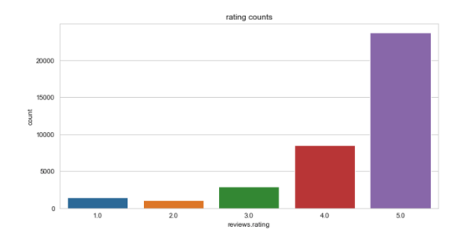
Exploratory Data Analysis contd. (Reena)
Final dataframe information
count plot of review.rating column after concatenation
Notes:
In order to carry out classification algorithms- Logistic regression and Random forest, we concatenated three dataframes data, data2, data3
We again plotted thto see if we have been successful in removing biasness in ratings.
Unfortunately, we are still seeing that rating '5' is far ahead of other lower ratings in the above figure. Still, there's biasness in our dataset.

Slide 28
Predictive Modeling using ML algorithms (Reena)
Steps followed to build predictive models
we assigned sentiments to all the ratings i.e. we assigned positive sentiment (1) for the ratings are 4 and 5 and assigned a negative sentiment (0) for the ratings are 1,2,3
we build the tfidf matrix to train models by importing TfidfVectorizer from sklearn’s feature_extraction.text family.
We then split our dataset into test and train subsets by keeping test size 0.3 where x_train and x_test included text element and y_train, and y_test included finalData["sentiment"] element
We first ran logistic regression model, and later random forest model
we then added a third label “neutral sentiment” value in the sentiment column for better results. We then mapped the sentiments i.e., positive sentiment, 1: neutral sentiment 0: negative sentiment corresponding to reviews
We again created a matrix of text of reviews.text column through vector transformation method
We again split our dataset into test and train subsets by keeping test size 0.3 where x_train and x_test included text element and y_train, and y_test included finalData["sentiment"] element.
we first ran logistic regression model, and random forest model

Slide 29
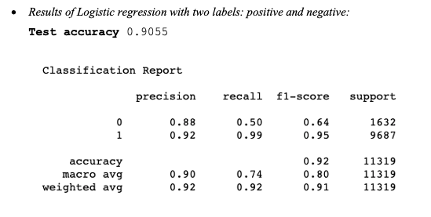
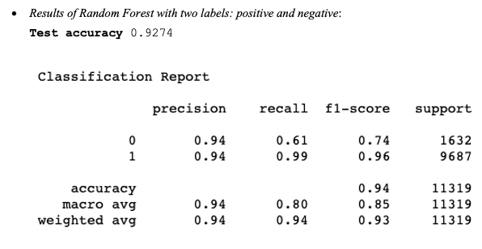
Model Results: Logistic Regression & Random Forest model with two labels (Reena)

Slide 30
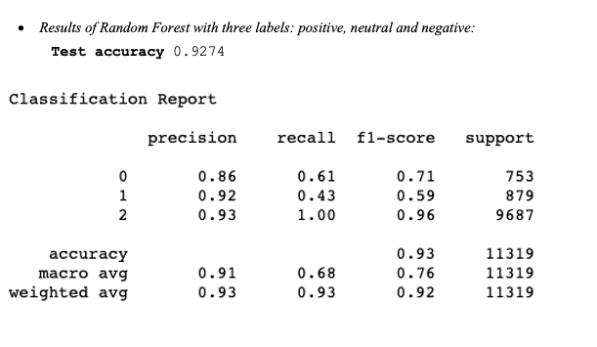
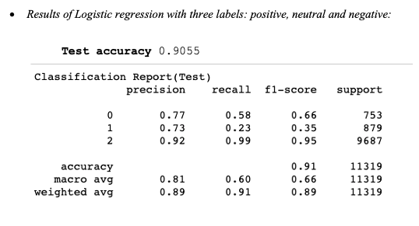
Model Results: Logistic Regression & Random Forest model with three labels (Reena)

Slide 31
Model Interpretation (Reena)
With Label 2:
The precision rate (0.94) for both negative and posistive sentiments is higher and performed better than Logistic regression. Even if we compare the recall and f1-score of negative sentiments, we will find that the Random Forests model (recall:0.61, f1-score:0.74) has performed better again than Logistic regression (recall:0.50, f1-score:0.64). In terms of accuracy rate, Random Forests model (0.9274) has performed better than Logistic Regression (0.9055).
With Label 3:
Accuracy score: Accuracy score of Random forest (0.9274) is higher than that of the logistic regression (0.9055). Precision scores for all three sentiments- negative:0, nuetral:1, positive: 2 are better in Random Forest model than logistic regression. Recall rates for all three sentiments- negative:0, nuetral:1, positive: 2 are better in Random Forest model than logistic regression. F1-score for all three sentiments- negative:0, nuetral:1, positive: 2 are better in Random Forest model than logistic regression

Slide 32
Final Conclusion (Buse, Reena)
Utilizing the IBM SPSS Modeler, we were able to determine:
There are more positive sentiment within the reviews then there was negative
Products with lower reviews are not very significant enough to predict the reason and the products with higher reviews are mostly superior that performs well in all aspects
Overall, the products that have been purchased and left a review on Amazon meet the expectation and satisfies the customers. This was validated by sentiment analysis in Python.

Slide 33
Final Conclusion contd. (Buse, Reena)
If we compare the performance of Logistic regression with that of the random forest after adding third label neutral sentiment, it is pretty apparently that based on:
Accuracy score: Accuracy score of Random forest (0.9274) is higher than that of the logistic regression (0.9055)
Precision scores for all three sentiments- negative:0, nuetral:1, positive: 2 are better in Random Forest model than logistic regression
Recall rates for all three sentiments- negative:0, nuetral:1, positive: 2 are better in Random Forest model than logistic regression
F1-score for all three sentiments- negative:0, nuetral:1, positive: 2 are better in Random Forest model than logistic regression
Through model evaluation, we have decided to go with the latest Random Forest model with label three as it provides better results.

Slide 34
Recommendation
Based on our analysis, we have tried to achieve the best possible score. However, the results could have been improved by:
Balancing the dataset either through increasing the number of negative and neutral labels or by decreasing the positive labels.
We could have applied 5-fold cross validation for parameter tuning using GridSearchCV method to arrive at optimal number of estimators and criteria either gini or entropy for splitting at features that attain least impurity for classification
We could have run ensembles of classification models to improve the overall performance of the model.
Overall, we’re satisfied that we were able to achieve desired results of model performances and understand thoroughly what people say good or bad about price and products that are being sold by Amazon on its own website.

Slide 35
References:
Amazon - The eCommerce Leader (2019 Infographic). (2020, November 21). Retrieved December 20, 2020, from https://www.16best.net/blog/amazon-ecommerce-leader-infographic/
Calvi, M. (2019, July 08). Amazon Reviews Sentiment Analysis. Retrieved December 15, 2020, from https://www.kaggle.com/lele1995/amazon-reviews-sentiment-analysis
Chavan, J. (2020, May 08). NLP: Tokenization, Stemming, Lemmatization, Bag of Words, TF-IDF, POS. Retrieved December 16, 2020, from https://medium.com/@jeevanchavan143/nlp-tokenization-stemming-lemmatization-bag-of-words-tf-idf-pos-7650f83c60be
Ghelber, A. (2020, March 04). Amazon Review Analysis: The Beginners Guide (2020) [Digital image]. Retrieved December 18, 2020, from https://www.revuze.it/blog/amazon-review-analysis/
Jayaprakash, A. (2020, November 1). Building a sentiment classification model [Digital image]. Retrieved December 15, 2020, from https://abinaya-j.medium.com/building-a-sentiment-classification-model-a2b5fe24e9a1
Sentiment Analysis Explained. (n.d.). Retrieved December 15, 2020, from https://www.lexalytics.com/technology/sentiment-analysis
Sentiment Analysis of Tweets. (2016, April 22). Retrieved December 16, 2020, from https://induchandra.wordpress.com/contact/
Zhang, Mick (2020). Amazon Reviews Using Sentiment Analysis. Retrieved December 18, 2020, from https://mickzhang.com/amazon-reviews-using-sentiment-analysis/

